Slide 1
Introduction to IoT
Dr. Bhawana Rudra
NITK

Slide 2
IoT= Services+ Data+ Networks + Sensors

Slide 3
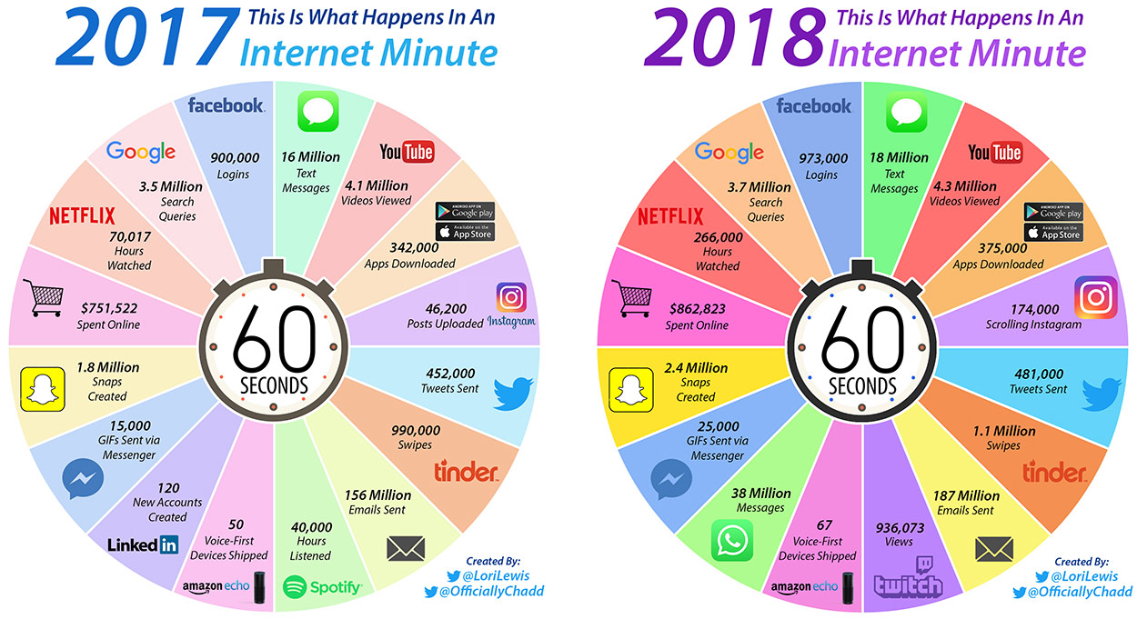

Slide 4
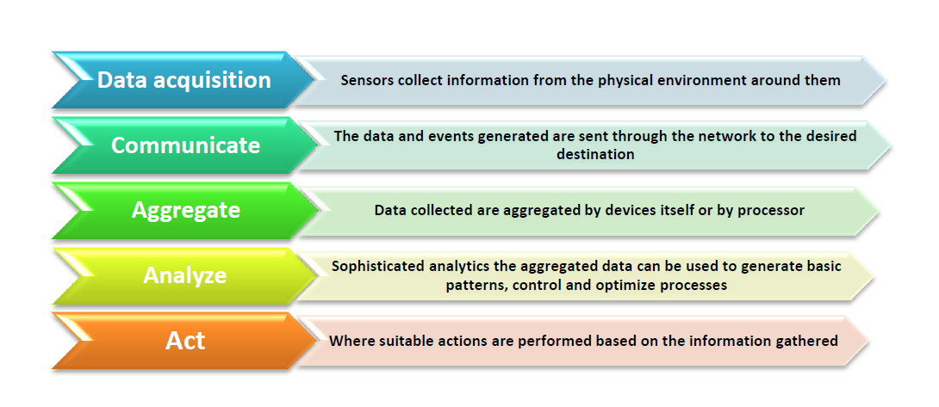

Slide 5
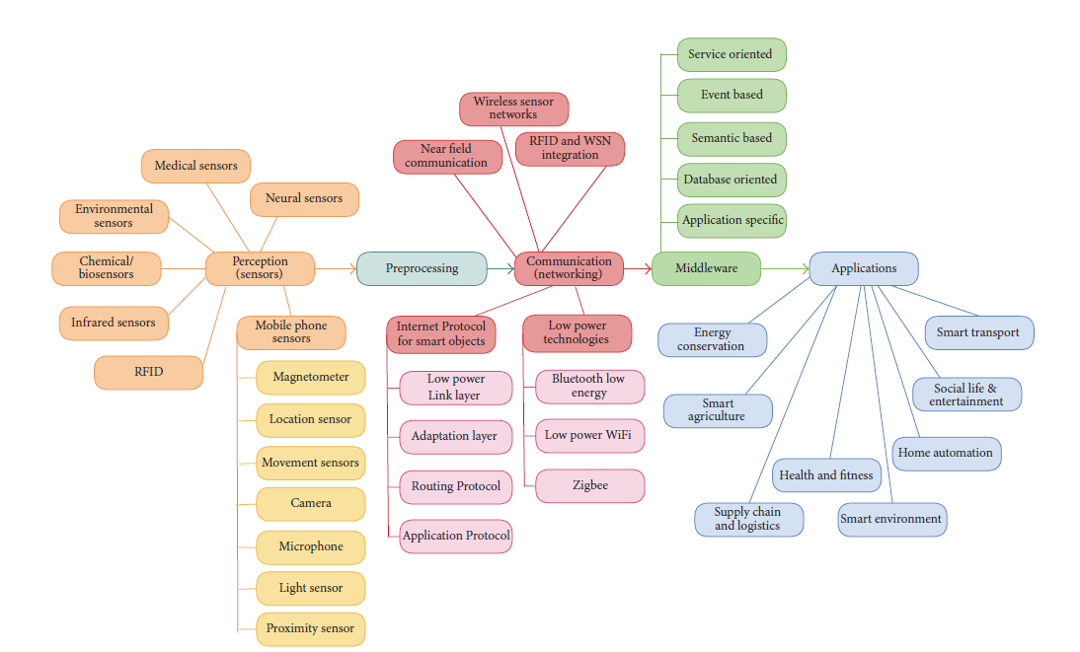

Slide 6
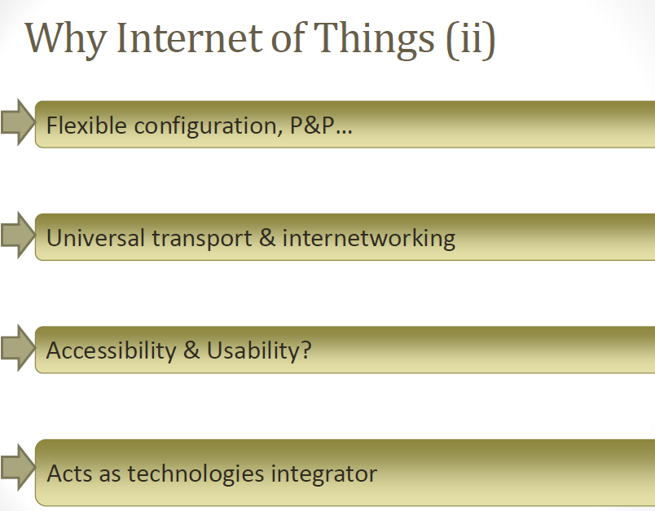

Slide 7
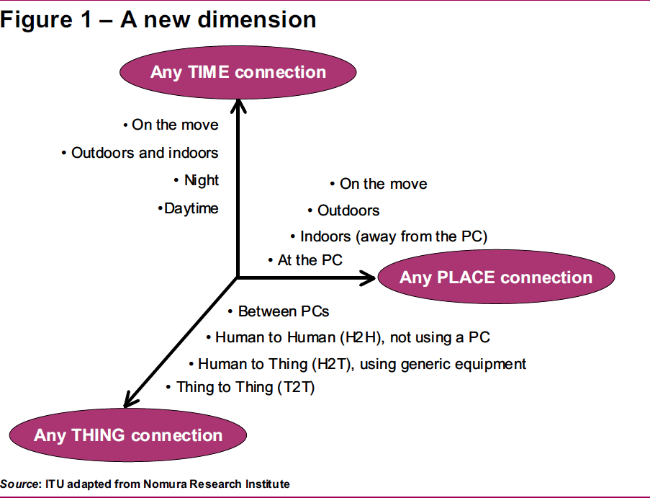

Slide 8
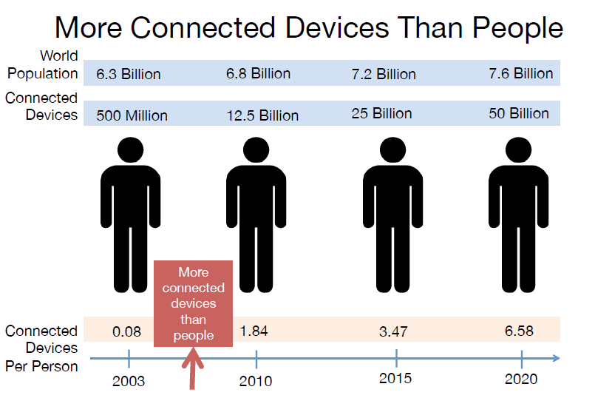
IoT connectivity

Slide 9
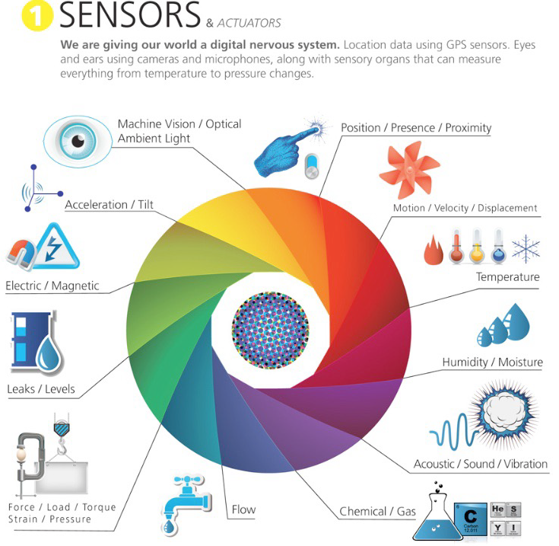

Slide 10
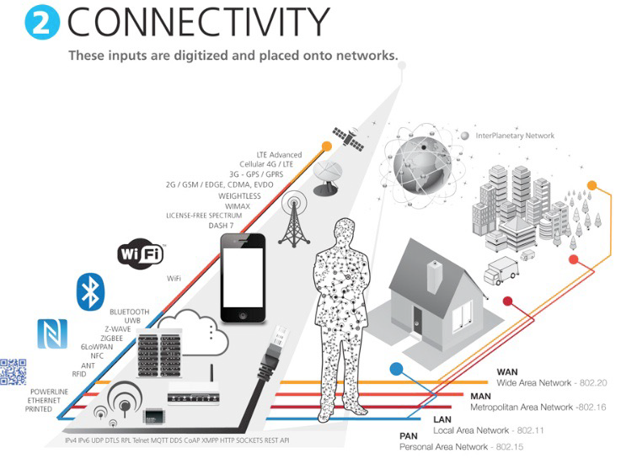

Slide 11
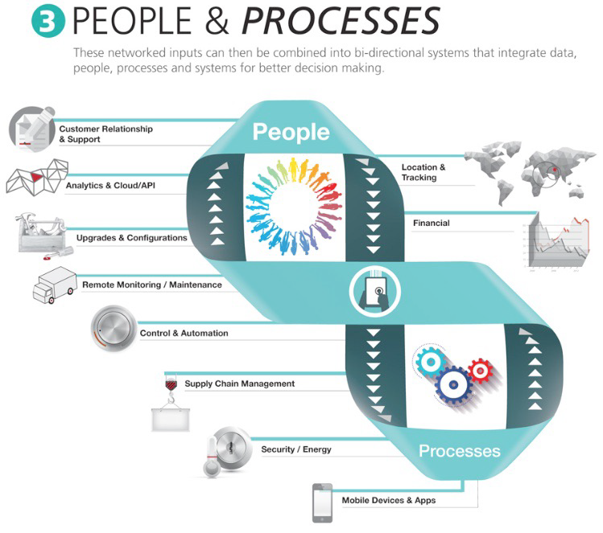

Slide 12
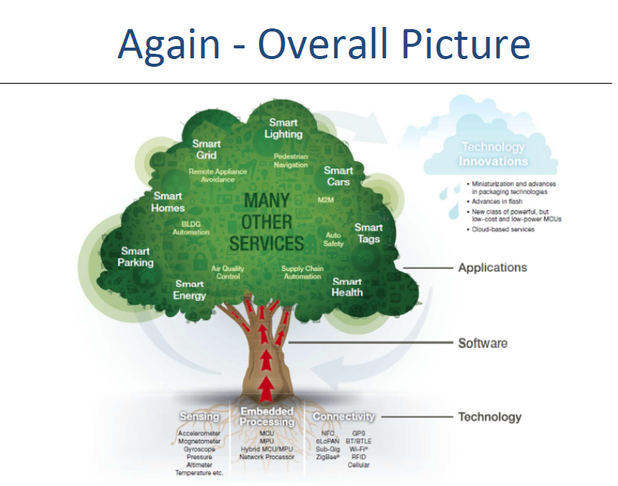

Slide 13
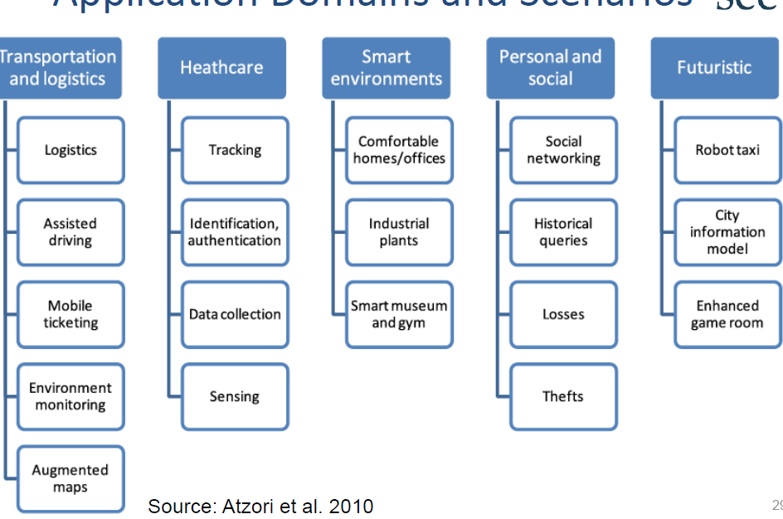

Slide 14
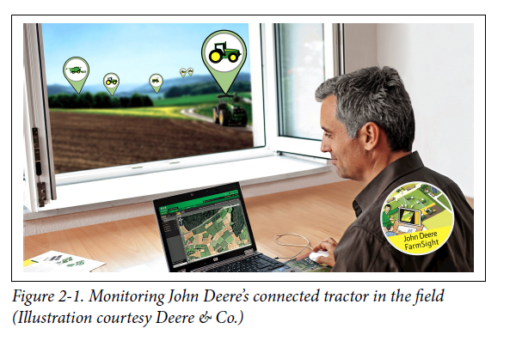

Slide 15
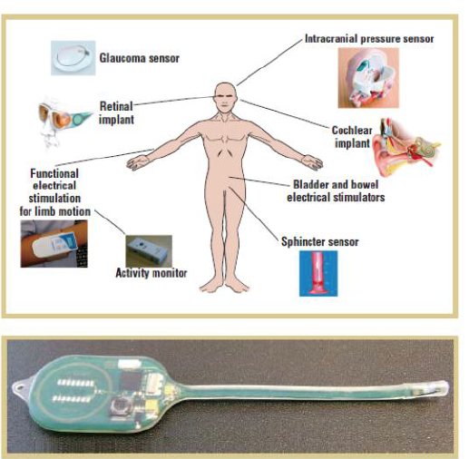

Slide 16
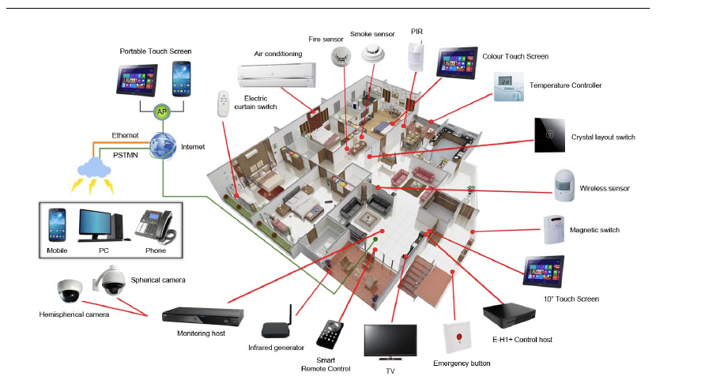

Slide 17
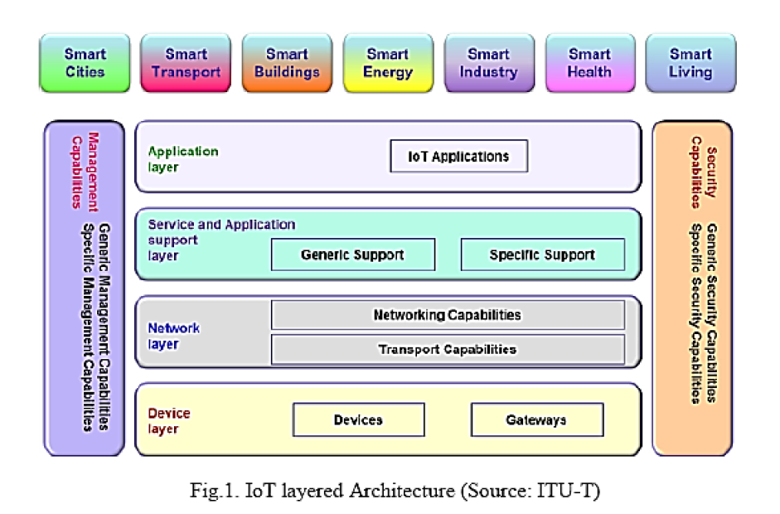

Slide 18
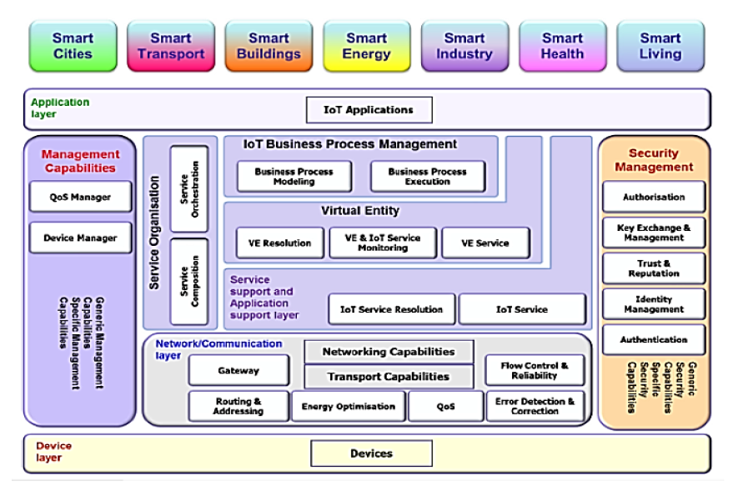

Slide 19
The transport layer transfers the sensor data from the physical layer to the processing layer and vice versa through networks such as wireless, 3G, LAN,Bluetooth, RFID, and NFC.

Slide 20
Classification of Sensors:
The sensors are classified into the following criteria:
1. Primary Input quantity (Measurand)
2. Transduction principles (Using physical and chemical effects): It is the fundamental criteria which are followed for an efficient approach. Usually, material and technology criteria are chosen by the development engineering group.
3. Material and Technology
4. Property
5. Application

Slide 21
Sensors classified based on power:
Active Sensor - Sensors that require power supply are called as Active Sensors.
Example: LiDAR (Light detection and ranging), photoconductive cell.
Passive Sensor - Sensors that do not require power supply are called as Passive Sensors.
Example: Radiometers, film photography

Slide 22
Cloud computing and IoT:
“Cloud computing is a method for delivery of computing requirements ‘as a service’ to the end user on demand”.
The term cloud theoretically signifies abstraction of technology, resources and its location that are very vital in building integrated computing infrastructure (including networks, softwares, applications etc).
Cloud can be built in many ways. Most common and famous method is by using Virtualization.

Slide 23
Virtualization:
‘Virtualization’ is the process of creating a virtual environment on an existing server to run your desired program, without interfering with any of the other services provided by the server or host platform to other users.
The Virtual environment can be a single instance or a combination of many such as operating systems, Network or Application servers, computing environments, storage devices and other such environments

Slide 24
Benefits of Virtualization:
Numerous benefits are provided by virtualization which includes reduction in costs, efficient utilization of resources, better accessibility and minimization of risk among others.
Benefits for Companies:
Removal of special hardware and utility requirements
Effective management of resources
Increased employee productivity as a result of better accessibility
Reduced risk of data loss, as data is backed up across multiple storage locations

